Slide 1
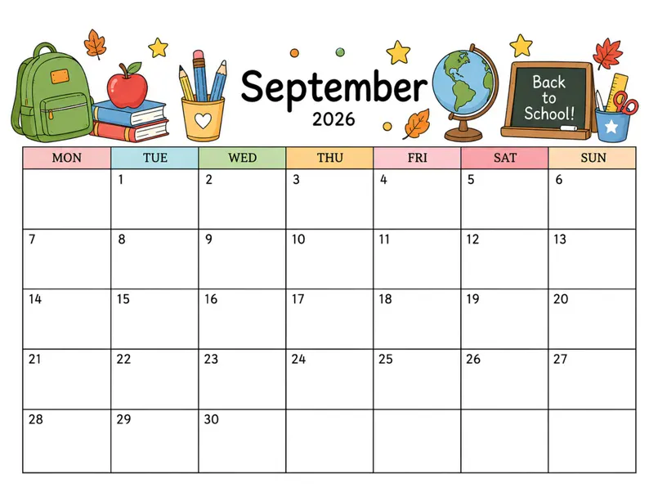



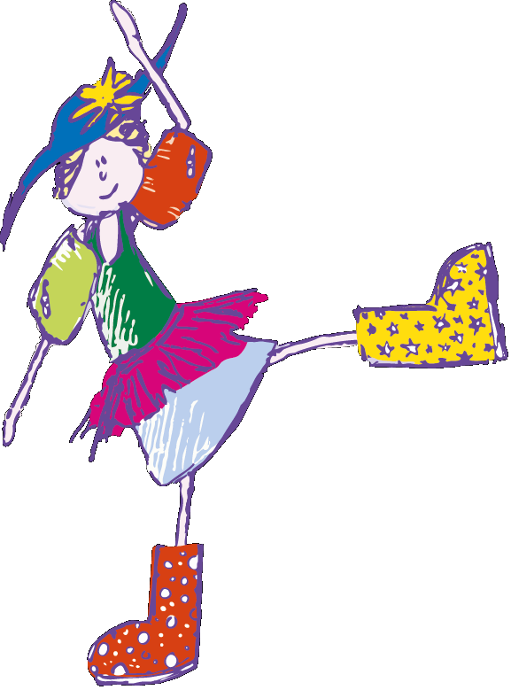


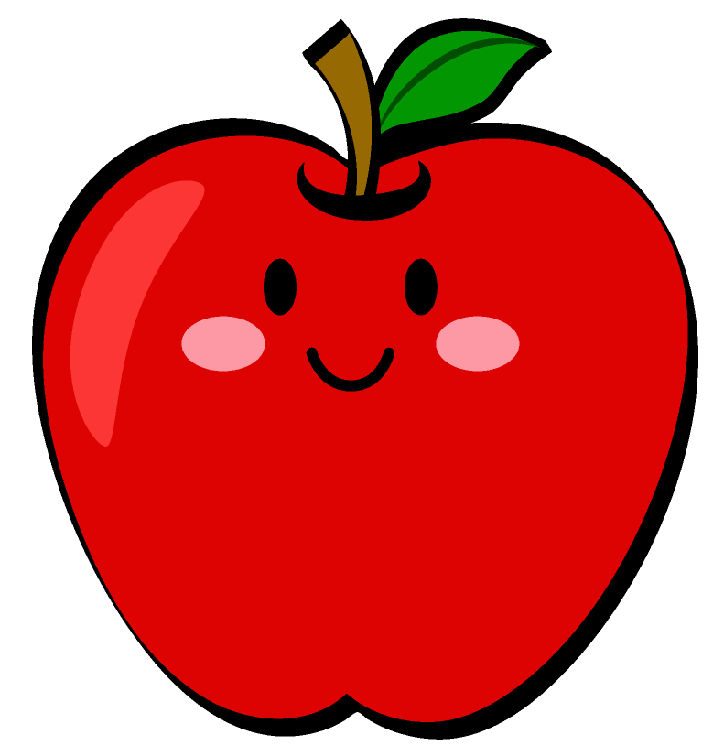
School
Handwashing
Germs
1st day of School
No School
Friendship &
Kindness
Mismatched
Day
Senses
Apples

